Slide 1
Comparative Analysis of software based intelligent autonomous driving architectures

Slide 2
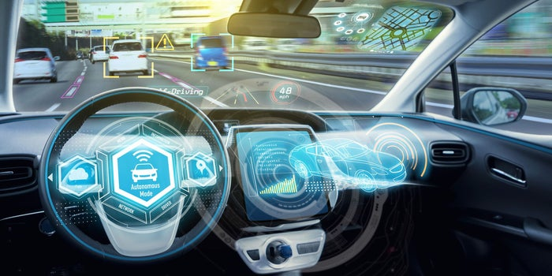
Autonomous cars
“Self-driving cars in which human drivers are never required to take control to safely operate the vehicle. Also known as autonomous or "driverless" cars, they combine sensors and software to control, navigate, and drive the vehicle. Currently, there are no legally operating, fully autonomous cars in the United States.”— UCSUSA

Slide 3

History
2004
2014
[YEAR]
Action
[YEAR]
Action
[YEAR]
Famous Event
The U.S. Defense Advanced Research Projects Administration (DARPA)
Nissan self-driving car The first such car to be permitted on Japanese roads, Nissan’s Autonomous Drive test car has been taking dignitaries for a ride – including Prime Minister Shinzo Abe. It is based on an electric Nissan Leaf.

Slide 4
Why autonomous car is future ?
First of all, people tend to be very bad drivers, so anything that would remove the human from control of the machine will improve the accident rate by a lot. And US drivers are worse than most, because they have almost no real training in driving before they get their license, and lose most of the training that they do have over the next several years. And then when drivers get old, and they tend to lose their focus on what they are doing, they get into even more accidents.
Secondly, driving stuff as a living is very expensive. So by having self driving vehicles (trucks, cars, buses, delivery vans, etc.) will reduce costs a lot and make for cheaper transportation.
Thirdly, because of so many accidents, insurance for drivers is expensive, and that creates a huge profitable industry to collect those funds and dole them out to the victims of accidents.
Finally, a large number of the victims coming to emergency wards in hospitals are there from the injuries received in accidents. Eliminating most of those accidents will reduce the load on our health care system, reducing costs for all.
And in addition, the biggest cause of traffic jams is from the bad and illogical driving from human drivers. Automated vehicles will be consistent, safe, and avoid traffic jams and construction by knowing how to avoid those situations. And in doing so, traffic will move more smoothly, and we will all get to where we want to go more quickly, and with less aggravation.

Slide 5
Things that help autonomous cars to drive
Sensor & Camera
Camera and Sensor are used to see the lane line in highway, speed sign, traffic light, and to identification and navigate accordingly.
Lidar (Light Detection and Ranging)
Lidar fire out millions of laser beams which scattered in 360deg every second of a autonomous car, which helps to measure how long their take bounce back, its form a 3D map of surrounding of car. Lidar can give perfect result up to 2.5cm. Multiple lider can give accurate map and avoid any blind spots.
High performance GPS (Global Positioning System)
GPS helps to locate the destination from source, location of your car, and the distance have to cover, accordingly to that it navigates itself. It can give perfect result within 4m RMS (Root Mean Square).
Artificial intelligence
Advance Driver Assistance System (ADAS), AI gives that power to an object to think and act like a human, it’s also provide the infrastructure around then V2X (vehicle to everything communication).
Local Data Processor
Data that are coming from radar, sensor, wheels, etc. are process in a very short time and action had to take in a moment. All the data process here and send to controle.
Machine Learning
Autonomous car has to think and act like human and the entire possible traffic rule, road situations are already feed into car, for feed all the think and make a machine think and act like human where machine learning comes.
Cloud base data processing & management
All the data are coming from different elements of autonomous car (camera, sensor, radar, etc.). All of that data are store in cloud.
Rader (Radio Detection and Ranging)
Rader bounce radio waves to see the surrounding, it is very good at identifying any metallic object; it can work where camera and lider are also not able to work (poor weather condition).

Slide 6
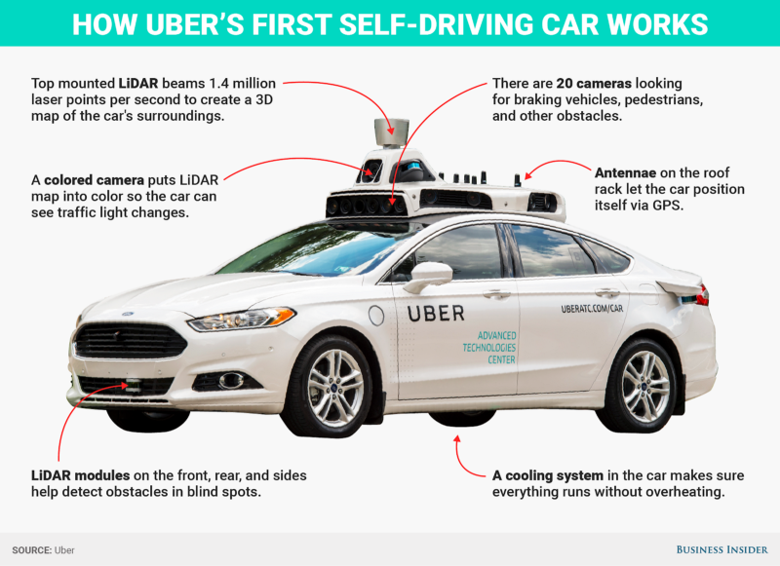
Technologies used in autonomous cars:
Laser range finder
The roof top of an autonomous cars has a rotating camera (capture 3D images of objects even when the weather condition is unclear), lidar, which use laser to find ranges with array of 64 laser beams, it calculate the distance and create an image of objects within the range of 200m .
Front camera
Front camera help to see the object that are nearby the car like traffic light, road signs.
Bumper mounted radar
There are 4 radars mounted on the front and rear bumper of the car, which help to make aware about objects behind and front of the car .
Aerial for geo location
An aerial on the rear of the car receives information about precise location of car using GPS satellites.
Ultrasonic sensors on rear wheels
Ultrasonic sensors are attached in rear wheels which help to detect and alert about obstacles, it keeps the track of movements of the car.
Inside the car
Altimeters, gyroscopes and tachymeters present inside the car detect the position of the car with various parameters by calculating highly accurate data .

Slide 7
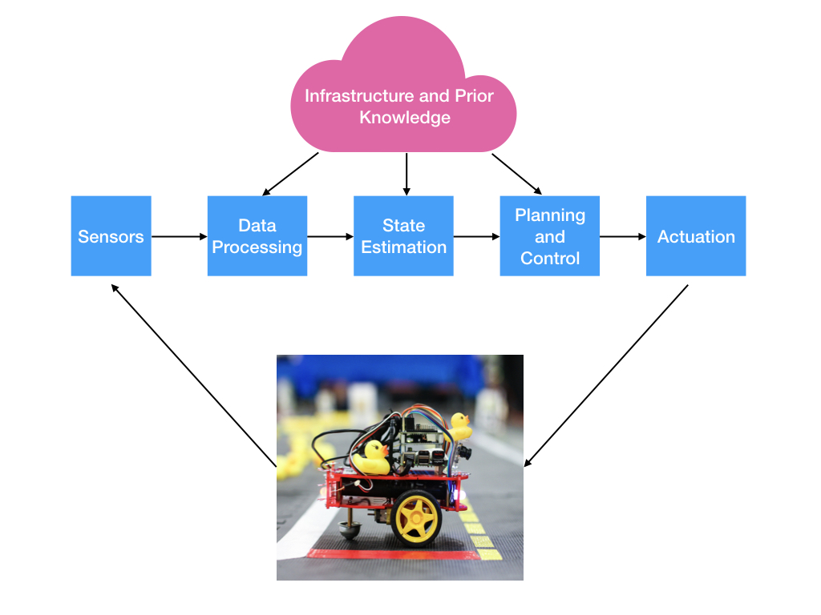
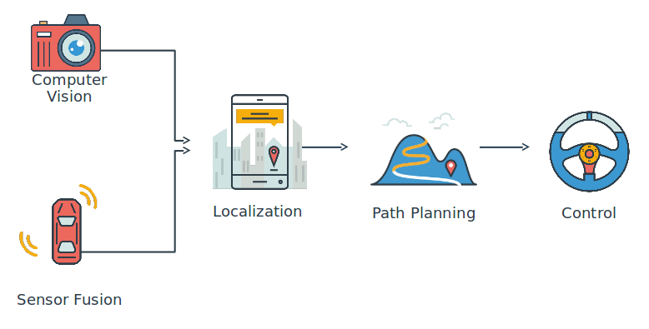
working

Slide 8
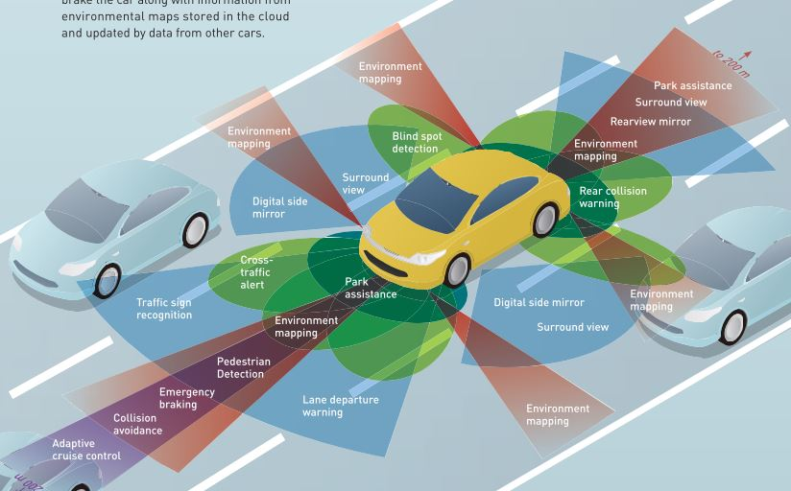
How sensors work in autonomous car

Slide 9
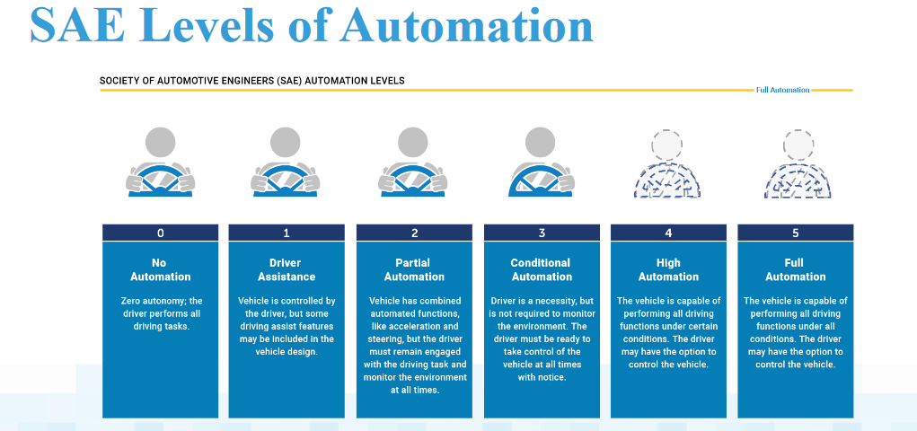
Levels of autonomous cars

Slide 10
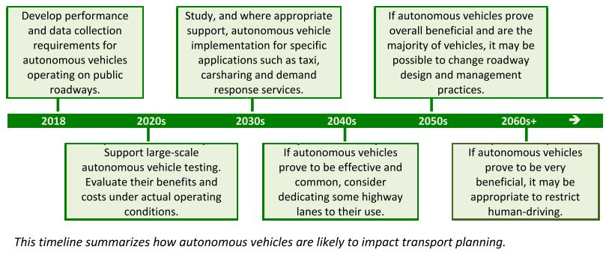
planning

Slide 11
Advantages and disadvantages
People who have difficulties driving—such as disabled people, older citizens, and children—would be able to experience the freedom of solo car travel.
Reduced need for safety gaps, lanes, and shoulders means that road capacities for vehicles would be significantly increased.
Over 90% of car crashes in the US are caused by driver error. There would be less user errors and fewer mistakes on the roads if all vehicles became driverless. Drunk and drugged drivers would also be a thing of the past, and passengers might even sleep without risking safety.
A self-driving car would be unaffordable for most people, likely costing over $100,000.
Truck drivers, taxi drivers, Uber/Lyft, and other delivery people will eventually lose their jobs as autonomous vehicles take over.
Self-driving cars would be great news for terrorists, as those vehicles could be loaded with explosives and used as moving bombs.
Hacking will be easy.

Slide 12
Why this topic ?
Self-driving cars are the future of automobiles industries .But still we can’t achieve the fully-automated cars yet. There are lots many problems are faced by autonomous cars industries. The Apple “Titan” autonomous car gets crash when there was no unusual condition. The Waymo got trouble to cross the t-intersection. Uber’s vehicle detected Herzberg 5.6 seconds before impact, but it failed to respond and can’t brake because it can detect her. Tesla’s Autopilot feature was active on a Model X SUV hammered into a genuine thruway path divider and explode into fire on the morning of Friday, March 23 2018. The driver (Wei Huang) died later at the hospital .
Problems like detection of any objects’ or any living beings, crossing the traffic, follow the traffic rules, calculation and respond time, maintaining the database, communication with other vehicles etc., are the area of main concern for autonomous car.

Slide 13
OBJECTIVES
To identify perception and control problems in existing automated driving applications.
Comparative Analysis of software-oriented autonomous Driving architectures.

Slide 14
Expected OUTCOME
The reliable intelligent driver assistance systems and safety caution until now we are lot behind the expectation. Improve in innovation can turn a computer operated cars with tires which will drive without any human commands. Human just have to provide the initial to destination, without any further command human can reach to destination with all safety precaution. It can reach out to incorporate various moves to make the driving outline equipped for managing every driving condition. Future issues may equally add in a calculation for self-driving cars. Later, with the present and developing knowledge with the importance of security, reliable self-driving cars can be developed for B2X.

